Slide 1



Credit Loan Defaults
Jennifer Melendez
Manal Bayoumi
Rocio Cantu
Johnny Truong

Slide 2
Agenda
1. Introduction
2. Default Factors
3. Machine Learning
4. Summary
5. Conclusion

Slide 3




Meet our team
Jennifer Melendez
Johnny Truong
Manal Bayoumi
Rocio Cantu
3

Slide 4
Introduction
In this presentation, we'll explore the key concepts behind credit loan defaults, understand factors that affect defaulting, and discuss their implications for the financial sector. By the end of this presentation, you'll have a deeper understanding of how machine learning is reshaping the landscape of credit risk assessment and its impact on the financial industry. Let's dive in.
4

Slide 5
Data Cleaning:
Before Cleaning:
At the beginning, the data had about 25 columns and about 30,000 rows.
After Cleaning:
Afterwards, the data has 18 columns and 30,000 rows.
We also removed duplicate cells and outliers.

Slide 6
Research Questions:
Can we create a machine learning model that can accurately predict defaults?
Why do people default on their loans?
Is it Income level?
Level of education?
AND WHY?!

Slide 7
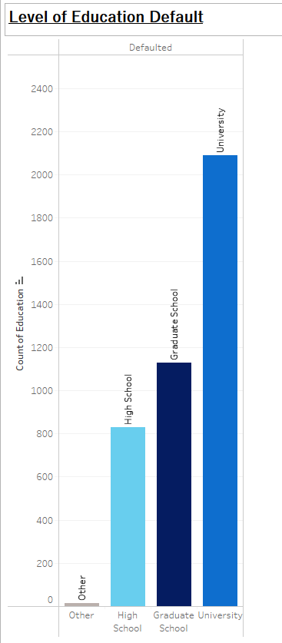
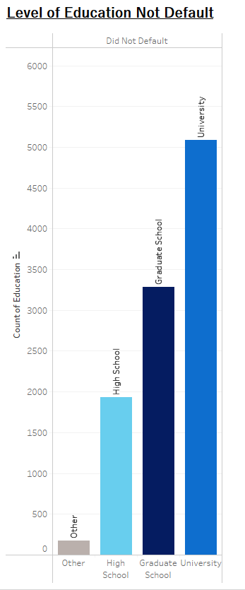
Default Factors: Level of Education
7

Slide 8
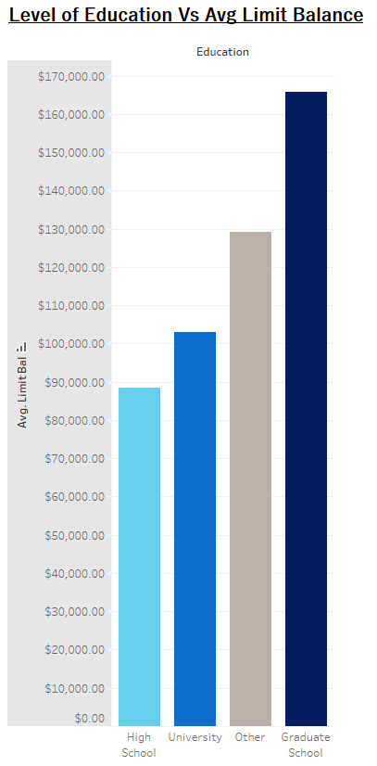
Default Factors:
Income Levels
As seen in the previous slide, the level of education that defaults the most on their loans are those who have graduated from University.

Slide 9
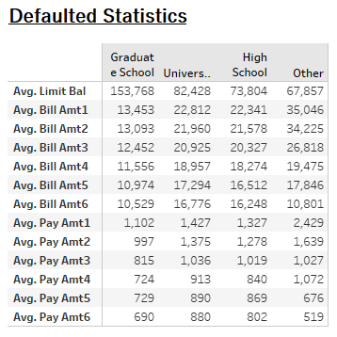
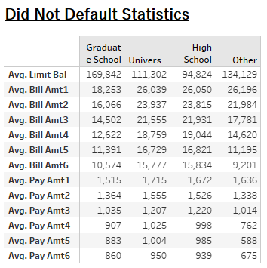
Statistics

Slide 10
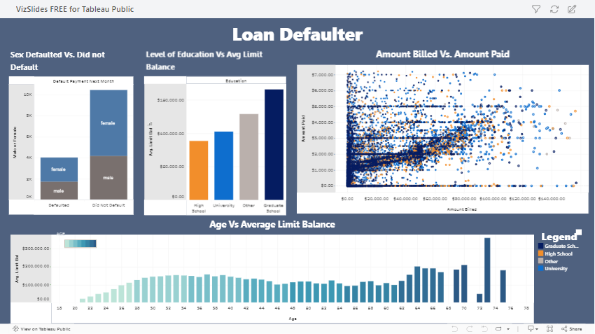

Slide 11
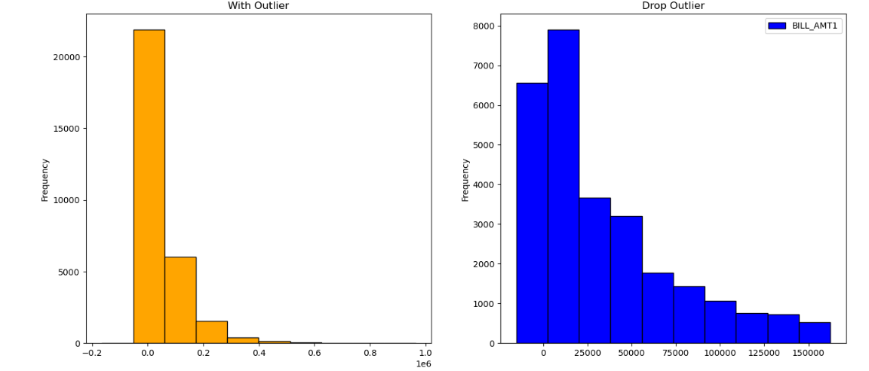
Areas of focus
11

Slide 12
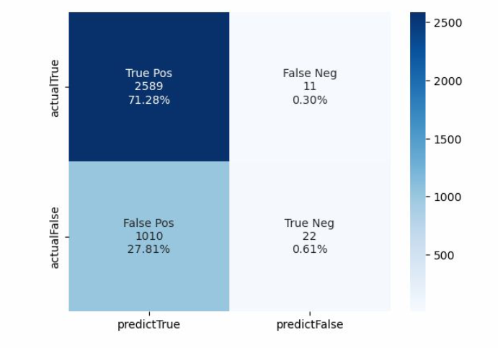
Machine Learning: Models
The accuracy for that model was approximately 71.88%. As for the precision, it reached 71.93%, and the recall score was 99.57%. When we used the random forest model, its accuracy level reached 73.26%. The precision level reached 75.96%, and the recall level reached 91.65%

Slide 13
Optimized the Model Using Grid Search
To find the best performance for a given dataset to achieve higher accuracy level.
That can be done by setting parameters for the grid space in terms of maximum depth, estimators, max features, and minimum samples.
The highest accuracy rate was 74%.

Slide 14
Summary
Objective: The objective of this project is to analyze the factors that contribute to credit loan defaults and develop a machine learning model to predict the likelihood of a borrower defaulting on a loan.
Model Development: Several machine learning models, including logistic regression and random forest were trained on the preprocessed data to predict loan defaults.
Results: The random forest model outperformed other models, achieving an accuracy of 74% in predicting loan defaults. Key factors contributing to loan defaults were found to be credit score, debt-to-income ratio, and loan amount.
14

Slide 15
Conclusion
This project demonstrates the effectiveness of machine learning in predicting credit loan defaults and highlights the importance of factors such as credit score and debt-to-income ratio in determining credit risk. By leveraging machine learning models, financial institutions can make more informed decisions and mitigate the risk of loan defaults.

Slide 16
Thank you!

